Slide 1
Motor Finance
Partner toolkit
February 2026

Slide 2
Contents
Overview
Info for your website and social media
Our advertising
Useful resources
Supporting the campaign

Slide 3
Overview
We are consulting on an industry-wide scheme to compensate motor finance customers who were treated unfairly between 6 April 2007 and 1 November 2024.
A compensation scheme is the best way to ensure consumers who have lost out receive fair compensation in an orderly, consistent, quick, and efficient way, while ensuring a well-functioning and competitive motor finance market.
We are communicating with consumers to raise awareness of a potential compensation scheme and inform them that they don’t need to use a claims management company to make a claim, as well as raise awareness of the presence of scammers using car finance as a hook.
This pack contains information and resources for you to share with consumers.

Slide 4

Campaign copy
To help you spread the word about our campaign, we’ve drafted copy that can be used for your website, newsletters and social media.
You can choose the length of copy that best suits the purpose of your content.
Please feel free to create your own content using our copy as a guide.

Slide 5
For your website
The Financial Conduct Authority (FCA) has proposed a compensation scheme for unfair motor finance agreements. The FCA estimates that people will receive around £700 per agreement on average, with payouts on 14 million agreements expected to start next year. The scheme would cover agreements between 6 April 2007 and 1 November 2024.
Motor finance companies broke laws and regulations in force at the time by failing to disclose important information. This led to unfairness, with consumers being denied the chance to negotiate or find a better deal and, in some instances, overpaying for their loan.
If you are concerned that you weren’t told key details about your motor finance arrangement, you should complain to your lender now if you haven’t already. Under the proposed scheme, lenders will have to contact customers where they have details. People who have already complained will be contacted first and so are likely to be compensated sooner than those who haven't.
You don’t need to use a claims management company or law firm to make a claim, and if you do so you could lose more than 30% of the money you’re owed. You can submit your own complaint, for free, using a template letter on the FCA’s website, fca.org.uk/carfinanceclaims.
The FCA will monitor if firms are meeting the proposed scheme’s rules and will act if they’re not. If you disagree with your firm’s decision, the Financial Ombudsman will be on hand to assess whether the scheme rules have been followed.
There have been reports of scammers contacting people and pretending to be from car finance lenders, offering fake compensation. It's important to remember there's no compensation scheme in place yet. If someone contacts you out of the blue and offers compensation, you should ignore it. You should also be aware of scammers pretending to be from the FCA. The FCA will never ask you to transfer money to them or ask for your bank account PINs and passwords.
Visit fca.org.uk/carfinanceclaims to get 100% of the facts.

Slide 6
For your social media
Short copy
(Fits within 280 character limit for X)
The @TheFCA is consulting on an industry-wide compensation scheme for car finance customers who were treated unfairly.
The scheme will be free, simple to use, and there's no need to use a claims company or law firm.
Find out more
Long copy
The Financial Conduct Authority [TAG] is consulting on an industry-wide compensation scheme for car finance customers who were treated unfairly.
Payouts on an expected 14m unfair car finance agreements could start later this year, under the proposals.
The scheme will be free, simple to use, and there's no need to use a claims company or law firm.
Find out more

Slide 7
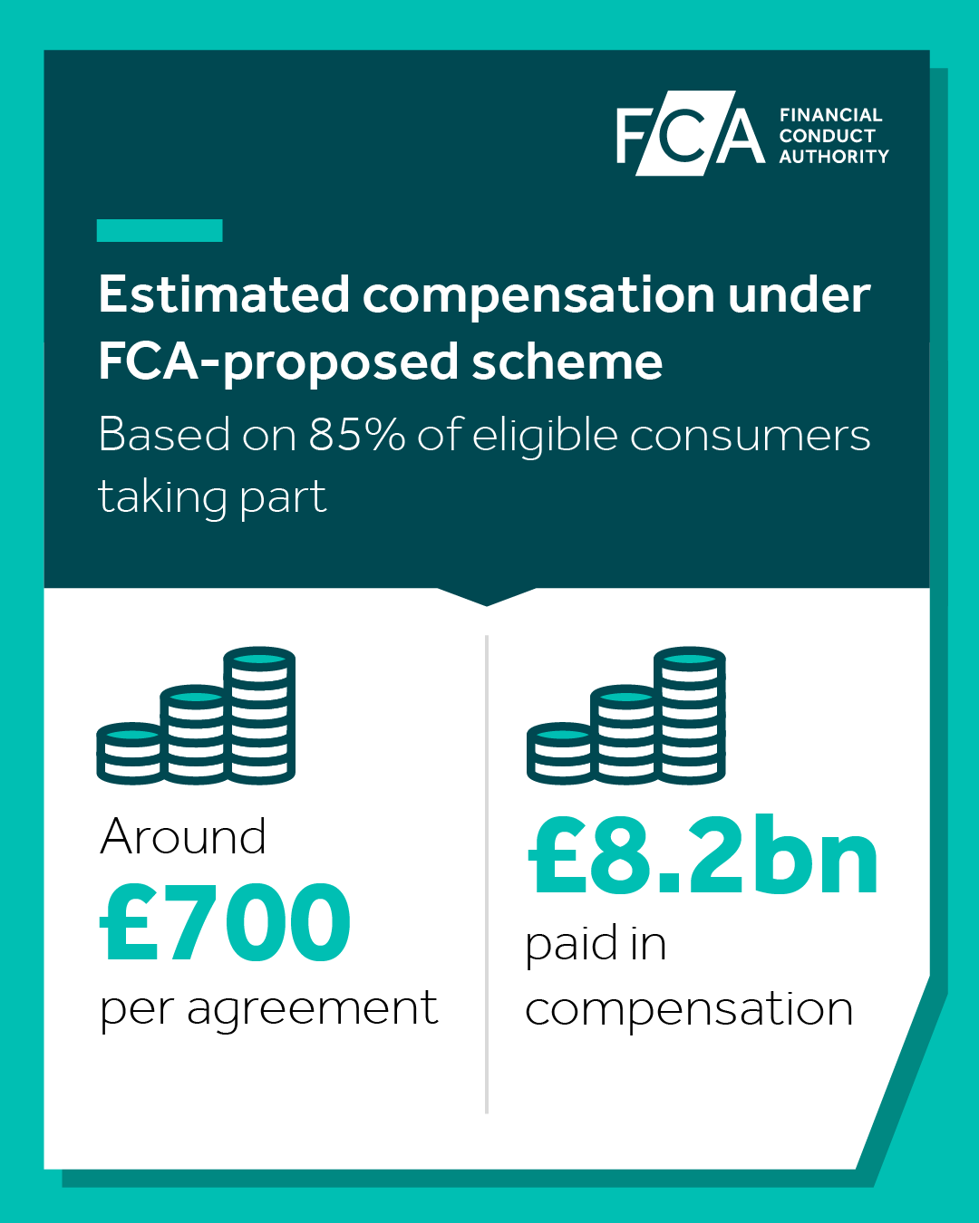
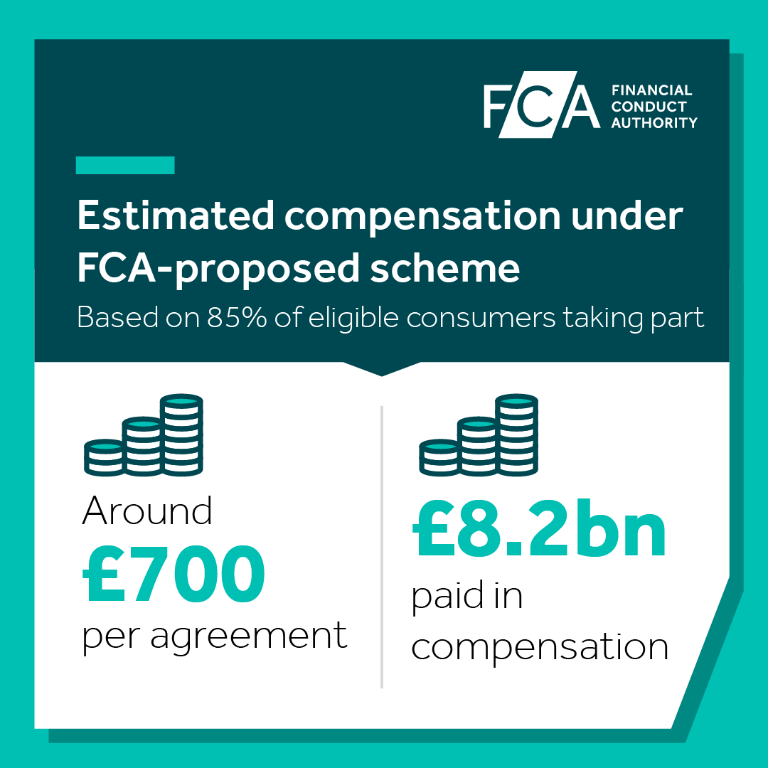
Social posts
You can use these images on your own social media by downloading the assets..
Download for X/LinkedIn
Download for Instagram

Slide 8

Don't rush, be ready assets
We've produced a series of posts that you can share on social media to support our consumer awareness campaign.
You can download both video and static assets using the button below and use our copy as a guide for your social posts.
Copy: Claiming on car finance? Using a claims company could cost you more than 30%. Get 100% of the facts, with the FCA. Go to fca.org.uk/carfinanceclaims
Download

Slide 9

Video advertising
Our social media and online video advert encourages consumers to visit the FCA website to get 100% of the facts.

Slide 10

Radio advertising
We have produced a radio advert to encourage consumers to visit the FCA website to get 100% of the facts.

Slide 11

Don't rush, be wary assets
To raise awareness of scams, you can support our campaign by sharing these assets on social media.
You can download both video and static assets using the button below and use our copy as a guide for your social posts.
Copy: Thinking of submitting a car finance claim? Scammers are out there. Get the facts directly from the FCA and shut them down. Go to fca.org.uk/carfinanceclaims
Download

Slide 12

Video advertising
Our social media and online video advert tells consumers not to engage with unsolicited contact from potential scammers.

Slide 13
Radio advertising
We have produced a radio advert to tell consumers not to engage with unsolicited contact from potential scammers.

Slide 14
Motor finance resources
Here are some useful resources from our website:
Consultation paper
Our press release
Our consumer page
Compensation scheme statement
Protect yourself from scams
Fake FCA communications

Slide 15



How you can support the campaign
As a partner, your support is valuable to us. We’ve created resources so that it’s easy for you to get involved in the campaign and spread the word on your own channels, including info that you can use on your website and social media.
Here’s how you can support the campaign on social media:
Engage with the FCA's social content (like, comment, reshare with your own message)
Create your own posts and tag the FCA social accounts
Financial Conduct Authority
@TheFCA
@financial.conduct.authority

Slide 16

Thank you
With your support we can help consumers get back what they’re owed.
If you’re looking for more ways to support the campaign, please contact
miten.patel@fca.org.uk

